Slide 1


Automotive Systems and Overview

Slide 2
Chassis Dynamometer:
A chassis dynamometer, informally referred to as a rolling road, is a mechanical device that uses one or more fixed roller assemblies to simulate different road conditions within a controlled environment, and is used for a wide variety of vehicle testing and development purposes.
Types of Basic chassis Dynamometer:
Tractive force control/Force constant
Speed control/Velocity constant
Road load simulation

Slide 3
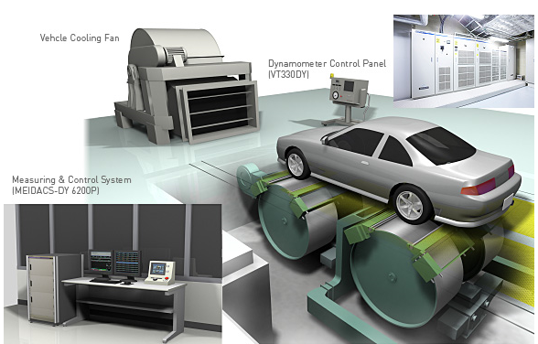
Picto

